Slide 1
Bookshelf
Software:
By : Team 10
Jayden Boomer, Manuel De La Cruz, Andy Do, Samuel Green,
Sharon Kopuri, Eli Mendez, Cassidy Pena

Slide 2
Table of contents
01
02
03
04
05
Objective
Cost, Effort & Price Estimation
Project Scheduling
How It Works
Conclusion

Slide 3
01
Objective

Slide 4
What is our Software & Objective?
Our Software will allow students to have their:
Books
Articles
Papers
Textbooks
And other
All in one place ! having it in one place it
allows a student to be able to:
Categorize them
Search for a specific word
Have notations
Bookmark a page
View annotated pages

Slide 5
02
Cost, Effort & Price Estimation

Slide 6
Team size: 7 developers
Focus:
  Centralized ebook storage
  Reading + search + annotation features
  Student- and researcher-friendly workflow
This section covers:
  Assumptions
  Effort breakdown
  Cost estimate
  Proposed price

Slide 7
Key Assumptions
Team size: 7 Developers
Workload: 5 hours/person/week (no weekends)
Hourly rate (hypothetical): $35/hour

Slide 8
Scope Included in Estimate
Management:
  Load books from folder (.txt, .pdf)
  Delete books
  Create/manage categories
  Search books by text
Reading:
  Page navigation (swipe / next–previous)
  Bookmark pages
  Day/night mode
  Word search within book
  Basic chapter navigation

Slide 9
Scope Included in Estimate
Notation:
  Add, view, edit, delete page notes
  View all notes in a book
Quality of Life:
  Zoom in/out
  Optional scrolling mode

Slide 10
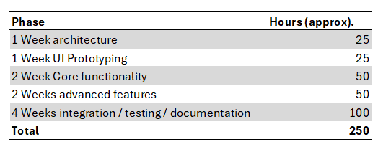
Effort Breakdown
Note: Effort includes design, coding, testing, and preparing final deliverables.

Slide 11
Cost Estimation
Total effort: 250 person-hours
Hourly rate: $35/hour (blended “company” rate)
Development cost calculation:
  250 × $35 = $8,750
Optional additional costs:
  Libraries / tools (PDF, UI, etc.): ≈ $500–$1,000
Estimated total project cost range:
  ≈ $10,000 - $12,000

Slide 12
03
Project Scheduling

Slide 13

Project Scheduling
Workweek | 01/05 | 01/12 | 01/19 | 01/26 | 02/02 | 02/09 | 02/16 | 02/23 | 03/02 | 03/09
Architecture
UI Prototyping
Core Features
Advanced Features
Integration / Testing / Documentation
Notes:
This is a Gantt chart of the project schedule.
We estimate that the project will take about 10 weeks overall, excluding weekends and assuming 5 hours of work per day per person.
We estimate that it would take 1 week to implement the project architecture, 1 week for UI prototyping, 2 weeks to implementat of the core functionality like importing and reading books, 2 weeks for the advanced features such as bookmarks, annotations, and user preferences, and then we give 4 weeks for integration, testing, and documentation.2

Slide 14
Project Scheduling
Activity | Duration / Date
Implementation start date | 11/20/2025
Project Architecture | 1 week
UI Prototyping | 1 week
Core Feature Implementation | 2 weeks
Advanced Feature Implementation | 2 weeks
Integration, Testing, Documentation | 4 weeks
Projected end date | 01/29/2026

Slide 15
04
How It Works

Slide 16
Functional Requirements
Import & Library Sync:
The system shall scan the configured “Books” folder for .pdf and .txt files.
The system shall import each discovered file into the library.
The system shall complete scanning and importing of up to 500 files within 10 seconds on the baseline machine.
The system shall ignore duplicate files that correspond to an already imported book.
Organize by Categories:
The system shall allow the user to create a category.
The system shall allow the user to rename a category.
The system shall allow the user to delete a category.
The system shall allow the user to assign and unassign a book to/from a category.
The system shall not delete any books when a category is deleted.

Slide 17
Functional Requirements
3. Text & Metadata Search:
The system shall allow the user to enter a text query.
The system shall search titles, authors, and full text of .txt and text-selectable .pdf books.
The system shall return search results for a library of up to 1,000 books within 1 second on the baseline machine.
The system shall display, for each result, the book title, author, and a short text snippet.

Slide 18
Non-Functional Requirements
Product requirements
  Performance/Efficiency
The system shall open a 50 MB PDF to the first visible page within 2.0 seconds on the baseline hardware.
The system shall complete a full-library re-index for 1,000 books or 3 GB within 60 seconds on the baseline hardware.
  Dependability/Reliability
The system shall achieve a crash-free session rate ≥ 99.5% over 1,000 test sessions.
The system shall maintain a consistent library state if an import operation is interrupted.
  Security Requirements
The system shall encrypt all local data (library database, annotations, settings) at rest using a strong industry-standard encryption algorithm (e.g., AES-256).
The system shall not perform any network access unless the user has explicitly opted in.

Slide 19
Non-Functional Requirements
2. Organizational requirements
Usability
The system shall allow at least 90% of novice users (n ≥ 10) to complete an initial task sequence (import a book, create a category, add a bookmark) without help within 3 minutes.
The system shall provide keyboard navigation for all interactive controls.
The system shall provide screen-reader-friendly labels for all actionable controls.
Environmental (Operating Constraints)
The system shall support Windows 10/11 and macOS 13+.
The system shall provide full core functionality offline.
Operational Requirements
The system shall perform an automatic daily local backup of the library database and annotations.
The system shall restore the library database and annotations from the most recent backup within 30 seconds.

Slide 20
Non-Functional Requirements
3. External requirements
Regulatory Requirements
The system shall honor OS-level data-deletion requests and provide a “Delete all data” function that wipes all local stores within 5 seconds on baseline hardware.
NFR-7.2 The system shall not attempt to bypass DRM or other copy-protection mechanisms on PDFs.

Slide 21

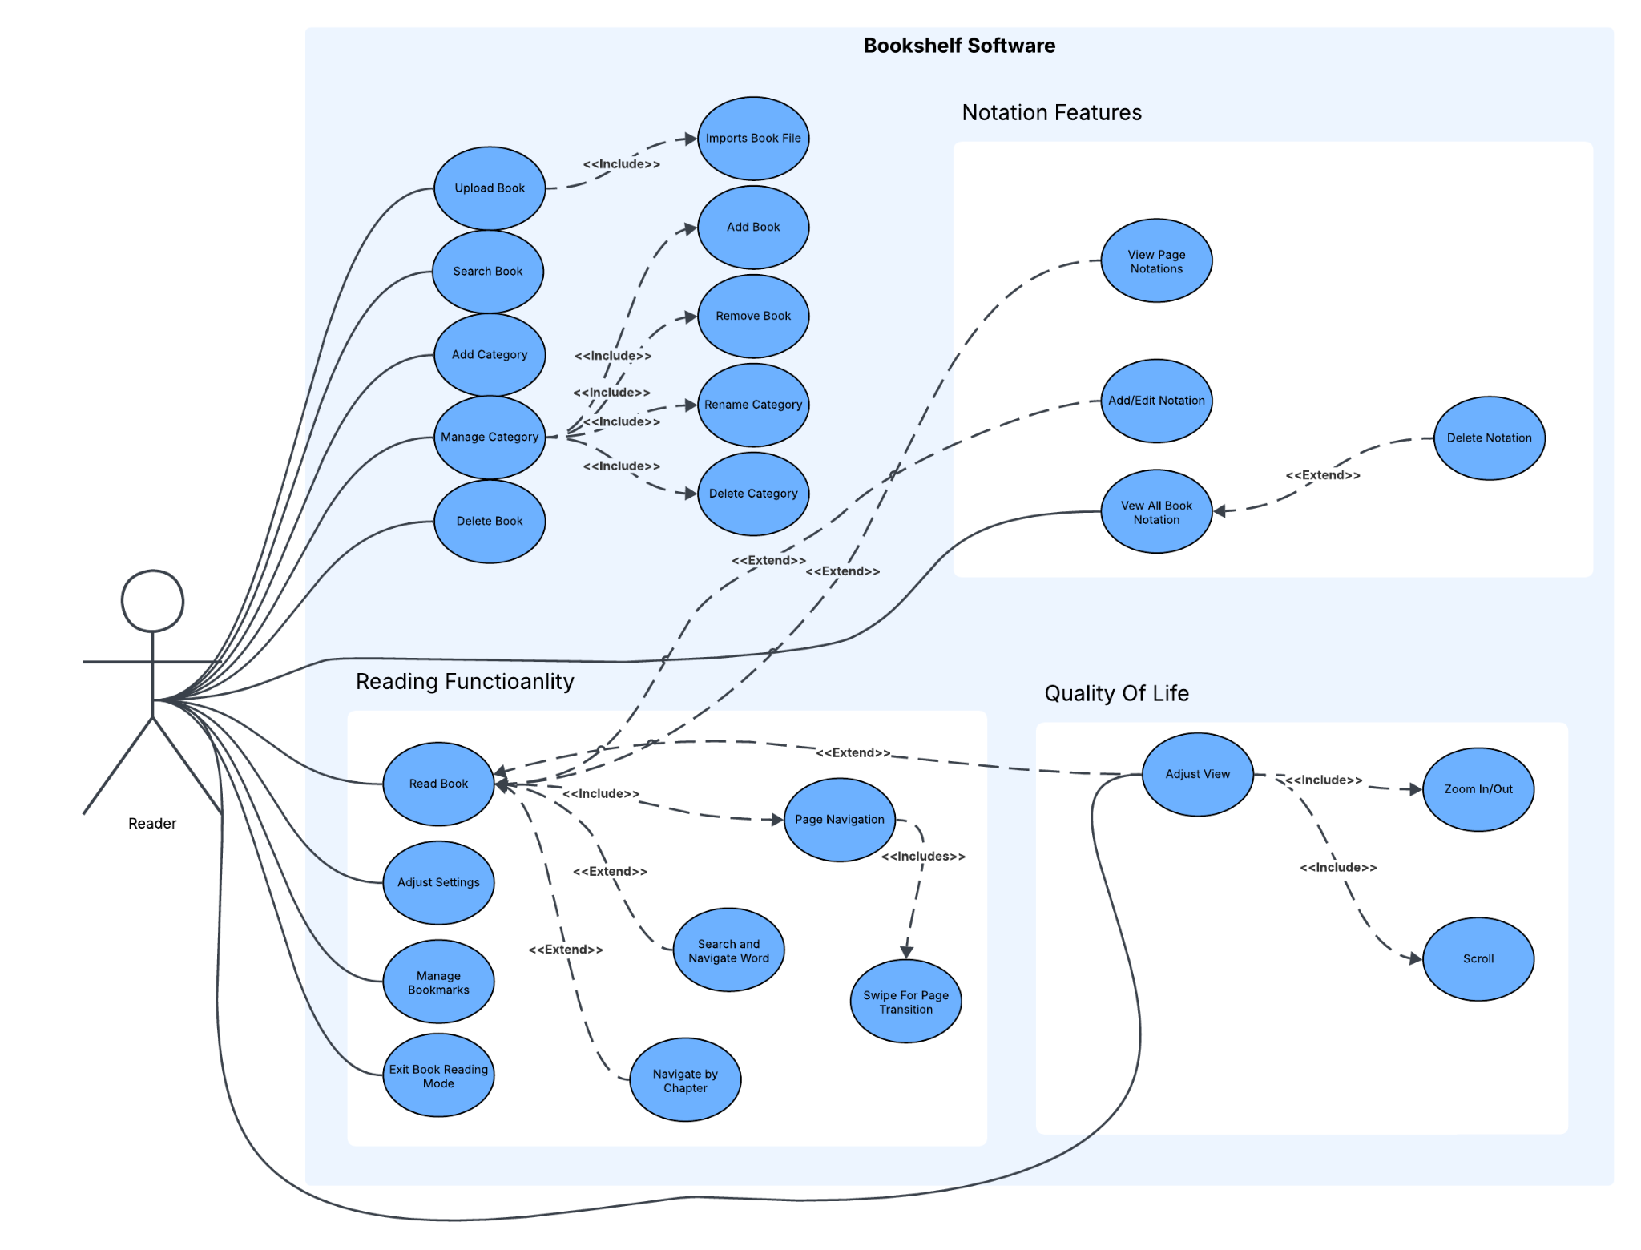
Use Case Diagram
The Use Case Diagram for our software consists of one Primary Actor being the “Reader”.
The reader interacts with different functions that we have categorized in 4 different groups:
Library Management
Notation Features
Reading Functionality
Quality of Life

Slide 22
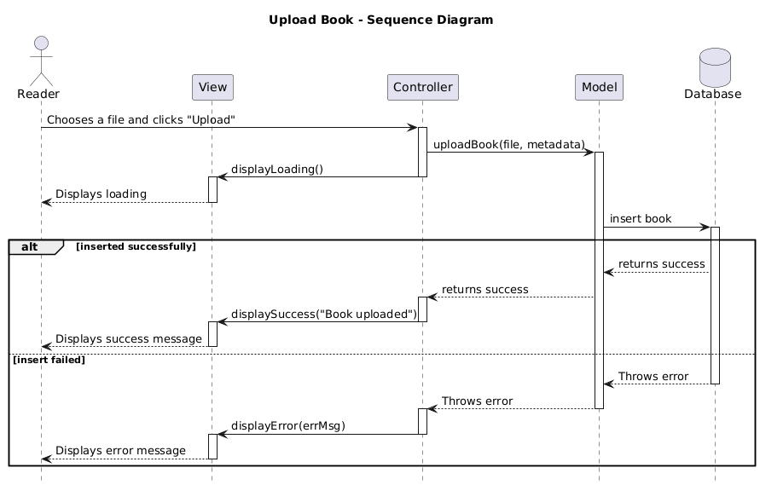
Sequence Diagram

Slide 23
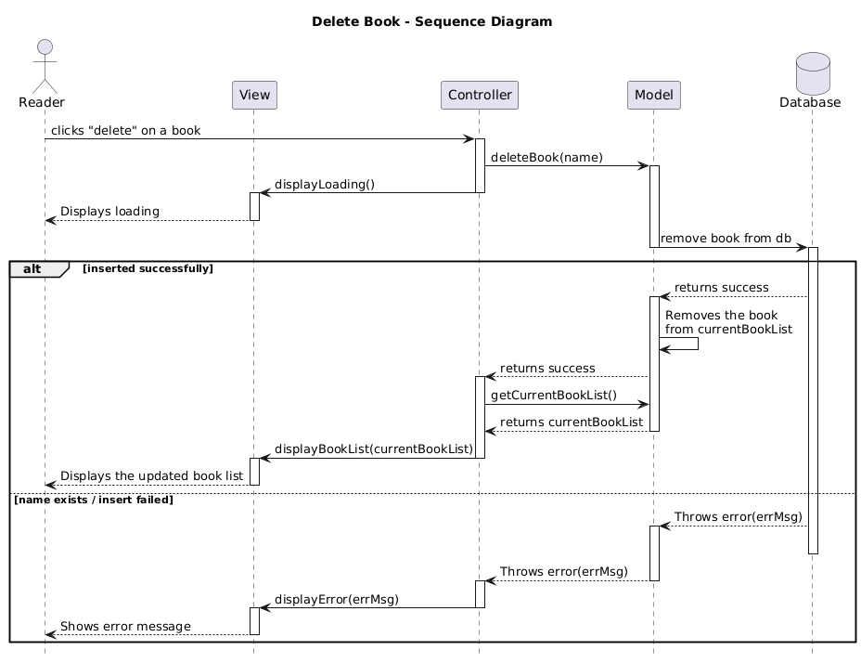
Sequence Diagram

Slide 24
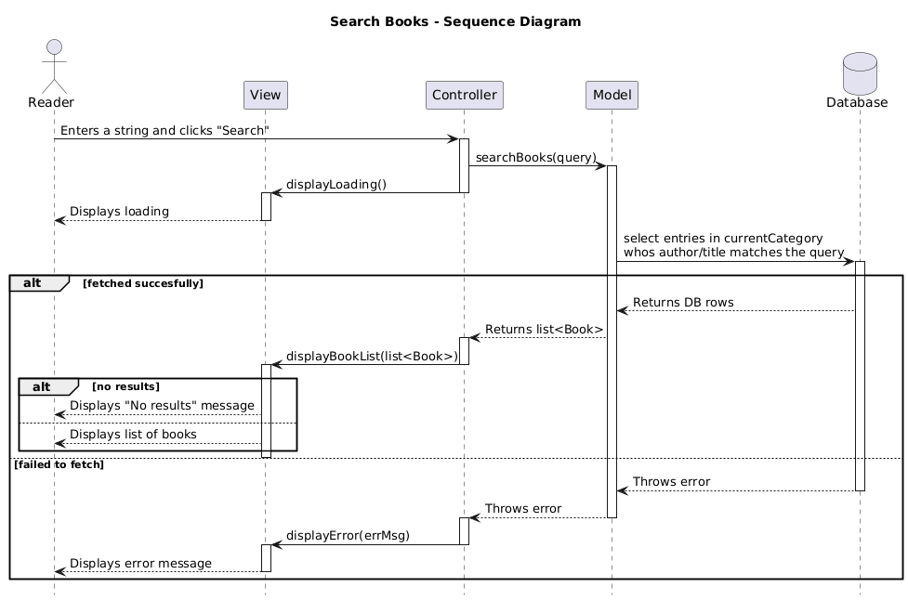
Sequence Diagram

Slide 25
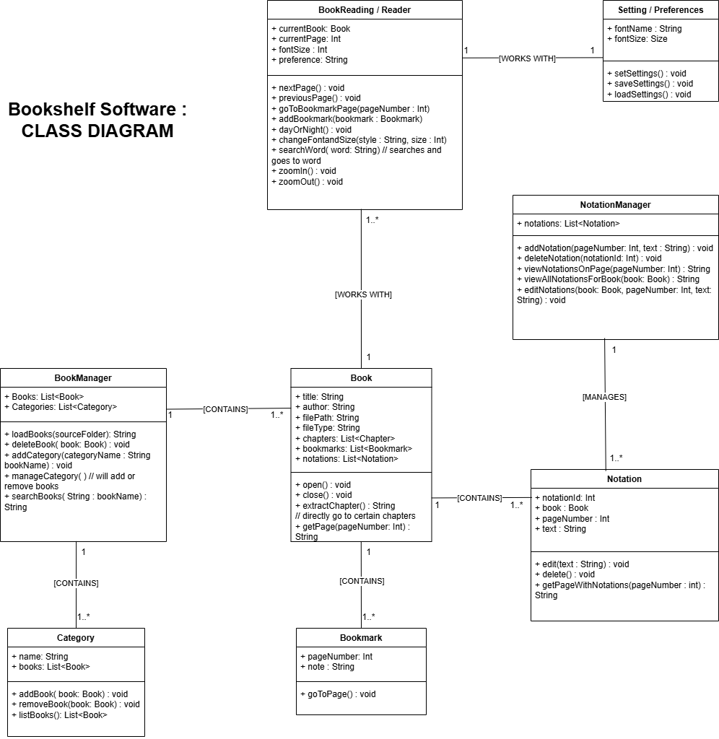
Class Diagram
There will be 8 main classes in this software, which are the following:
BookManager
Category
Book
BookMark
BookReading / Reader
Setting / Preferences
Notation Manager
Notation

Slide 26
Class Diagram
The following relationships in the class diagram include:
BookManager contains 1 or more Categories
BookManager contains 1 or more Books
Book contains 1 or more Bookmarks
Book contains 1 or more Notation
BookReading works with settings
NotationManager manages 1 or more notations

Slide 27
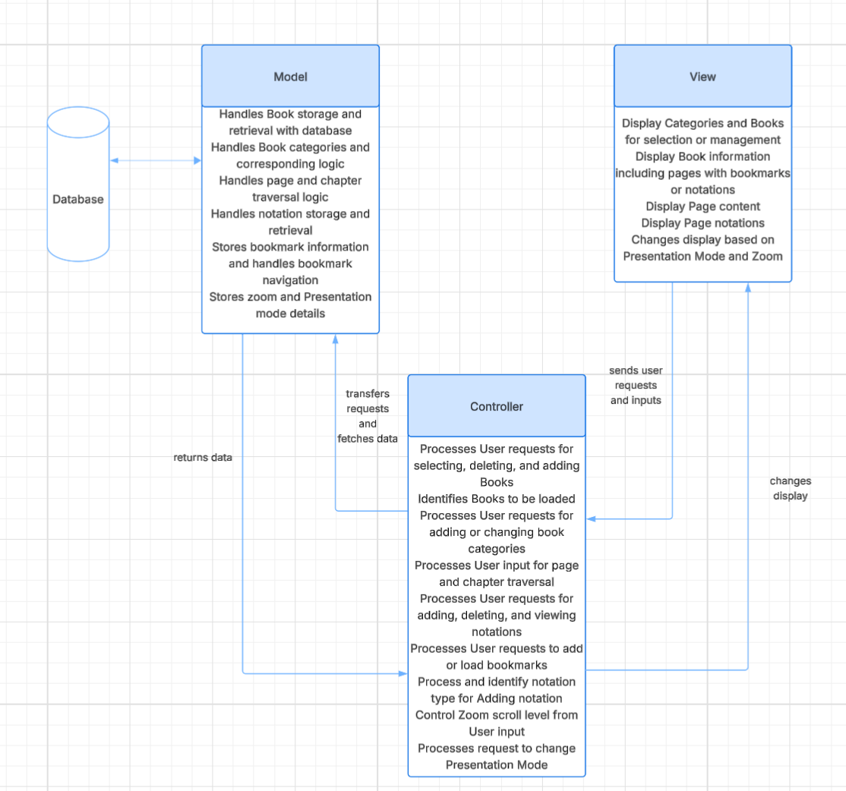
Architectural Design:

Slide 28
05
Conclusion

Slide 29
Conclusion
The overall planning of implementation that we had set in deliverable one, carried its way over to our final plan. We did not encounter any need for big changes that moved us away from our MVC pattern or our incremental process model.
We feel that the lack of changes are a result of the flexibility of what we had in our original plan and mainly due to two main things:
MVC Pattern: The pattern we chose for our software development has a strong separation of concerns which makes it simple to define test plans for individual components, without bringing up major flaws in the design logic.
Incremental Process Model: This model that we chose is designed to handle and prioritize work. We felt it fit perfectly with how things were being developed according to our project schedule. It allowed us to align core features and advanced features within their respective stages and increments.

Slide 30
Thank you!
Do you have any questions?
bookShelfSoftware@gmail.com
+91 620 421 838
bookShelf.com

Slide 31
References
GeeksforGeeks. “MVC Design Pattern.” GeeksforGeeks, 18 Aug. 2017,
www.geeksforgeeks.org/system-design/mvc-design-pattern/.
GeeksforGeeks. “MVC Architecture System Design.” GeeksforGeeks, July 2024,
www.geeksforgeeks.org/system-design/mvc-architecture-system-design/.
GeeksforGeeks. “Class Diagram | Unified Modeling Language (UML).” GeeksforGeeks,
30 Aug. 2018,
www.geeksforgeeks.org/system-design/unified-modeling-language-uml-class-diagrams/.
“Examples of class diagrams for softwares” prompt. ChatGPT, 23 Mar.version, OpenAI,
4 Oct. 2023, chat.openai.com/chat
Sommerville, Ian. Software Engineering. 10th ed., Boston, Pearson Education Limited, 2016.

